Slide 1
Global Marketing
Management
A European Perspective
Global Competition and Strategy
Warren J. Keegan
Bodo B. Schlegelmilch

Slide 2
Global Competition and Strategy: Important Concepts
Five Forces Model
Generic Strategies
Playing the Spread
Strategic Groups
Hypercompetition

Slide 3
Dimension of Global Competition
A company`s success in global markets is determined by its ability to establish competitive advantages
Forces influencing competition in an industry need to be examined
Analysis of a firm`s position within an industry is important

Slide 4
National Competitive Advantage: Factor Conditions
Human Resources
Physical Resources
Knowledge Resources
Capital Resources
Infrastructure Resources
Alternative Categorisation of Factors

Slide 5
Firm Strategy, Structure, and Rivalry
Differences in management styles, organisational skills and strategic perspectives create advantages and disadvantages for firms
Domestic rivalry has a powerful influence on competitive advantage, because it keeps an industry dynamic and creates pressure to improve and innovate
Intensity of competition and quality of competitors are important

Slide 6
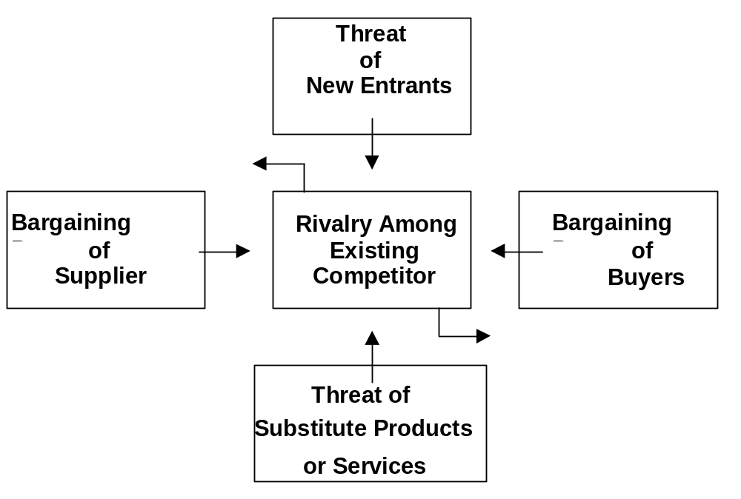
Industry Analysis
Five Forces Model

Slide 7
Industry Analysis
Threat of new entrants
Threat of substitute products
Bargaining power of suppliers
Bargaining power of buyers
Rivalry among competitors

Slide 8
Characteristics of Strategic Groups
Mobility Barriers
  Limit access to specific industry and switch between strategy groups
Varying level of bargaining power with consumer and supplier
Threat of Substitutes
  Companies serving special needs are less vulnerable

Slide 9
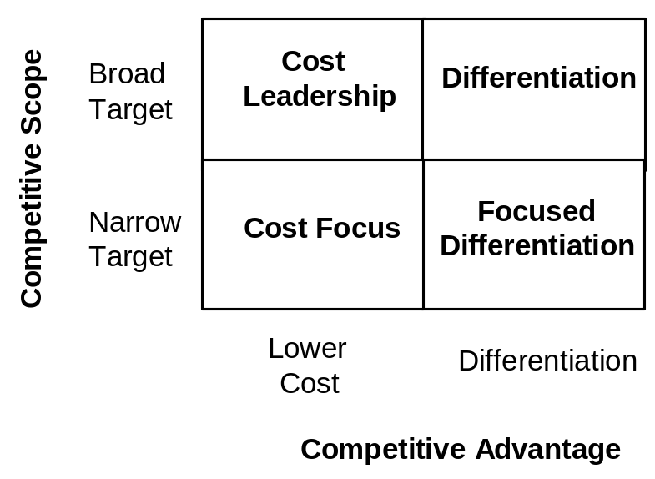
Competitive Advantage of Individual Companies (1)
Generic strategies for creating competitive advantages

Slide 10
Competitive Advantage of Individual Companies (2)
Broad Market Strategies
  Cost-Leadership Advantage
  Differentiation
  Narrow Target Strategies
  Focused Differentiation
  Cost Focus
  Playing the Spread

Slide 11
Hypercompetition
Porter`s models only provide snapshots of competition
“Hypercompetition” describes a dynamic, competitive world, in which no action or advantages can be sustained for long
The only advantage of a companies is to manage dynamic strategic interactions: Cost-quality, timing and know-how, entry barriers and deep pockets
Companies must seek unsustainable advantages

